Slide 1
11th Grade Bridge Law Counseling Lesson
Your School Counselors

Slide 2
Who is your school counselor?
Notes:
Please insert department information on this slide.

Slide 3
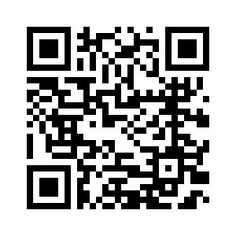

Slide 4
Learning Objectives
This lesson is to assist juniors in planning for their final semesters of high school and life once they have graduated. This lesson will provide steps and options for all students to take depending on their individual paths.

Slide 5
Let’s talk about…
Junior Advisement & IGP
Post-Secondary Options
HOPE Programs & Financial Aid
Dual Enrollment
Naviance

Slide 6
JUNIOR ADVISEMENT & IGP

Slide 7
JUNIOR ADVISEMENT & INDIVIDUAL GRADUATION PLAN
ADD DETAILS FOR YOUR SCHOOL’S PLAN
WHO – 11th Grade Students/3rd Year Students
WHAT – Junior Advisement
WHERE – Counseling Offices
WHEN – October 23 – December 1
WHY – Discuss Post-secondary options and Graduation Plan

Slide 8
POST-SECONDARY OPTIONS

Slide 9
What do I need to know?
What’s my path after high school?
What are the requirements to get there?
What tests do I need to take?
How do I pay for it?

Slide 10
Post-secondary options
Apprenticeships and Job Training
Military
Specialty School
2-Year and/or Technical College
4-Year College/University
Other?
Notes:
On-the-job training: short-term or long-term training is provided by an employer at the beginning of a new job
Military: 6-11 weeks of basic training when you join the Army, Navy, Air Force or the Marines
Specialty school: enroll in schools like Full Sail, Nashville Diesel, Cordon Bleu, Paul Mitchell, etc.
Technical School: enroll in a certificate or diploma program to prepare for a specific career
2-year community college: earn an Associate’s degree or take courses that will transfer to a 4-year college/university
4-year college/university: earn a Bachelor’s degree for a broad-based education and a specific education in a chosen subject area, or major

Slide 11
Trades and Apprenticeships
Occupations such as skilled construction work are considered trades or crafts.
The completion of an apprenticeship is generally associated with skilled labor. Training lasts 1 - 5 years, and provide on-the-job training, often paid. These kinds of programs can lead to secure and well-paying jobs. Additional education and training can provide high levels of advancement and increased salaries.
Notes:
Emphasize that there are some excellent and very well paying careers that offer apprenticeships or on the job training. Most apprentices are paid while they work, reducing the burden of student loan debt and accelerating individuals into well paying and stable careers.
Counselors can lessen the information on the slides if needed for visual reasons but be sure to share all info!

Slide 12
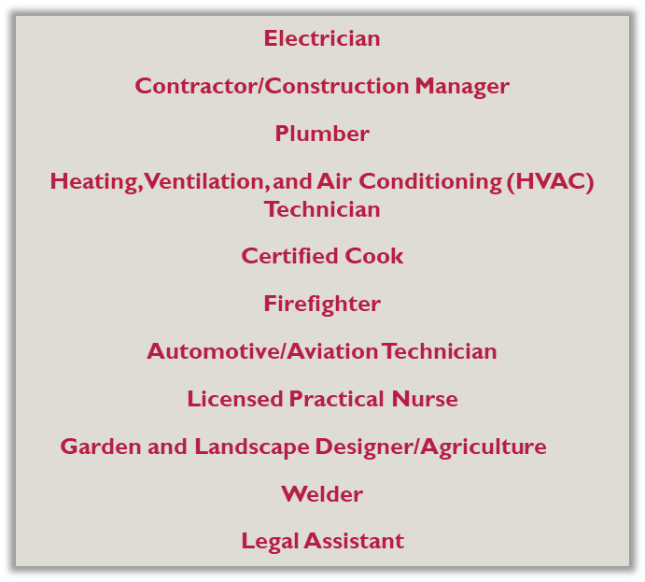
Trade Examples

Slide 13
Apprenticeships & Workforce
On-the-job training
Provided by employer
Related to skilled labor and training for actual jobs
Can lead to high-paying secure jobs.

Slide 14
State Workforce development initiatives
https://linktr.ee/GAWorkForceDevInitiatives
Visit the linktree listed above (or scan the QR code) to learn about several workforce development initiatives in Georgia.
HOPE Career Grant
The HOPE Career Grant can be the boost a student needs to get started on a rewarding career in a well-paying job, and without accumulating a lot of student debt. It also helps Georgia employers by creating a pipeline of skilled workers they can hire well into the future.
To be eligible for the HOPE Career Grant, students must first qualify for and be receiving the HOPE Grant. The two grants together will cover all tuition in these 17 programs of study.
https://tcsg.edu/free-tuition/
https://www.gafutures.org/hope-state-aid-programs/hope-zell-miller-grants/hope-career-grant/
Notes:
In pairs or small groups, have students research and then share with the group about one of these state workforce development initiatives. Use the linktree QR code or link as listed to help their research

Slide 15
HOPE Grant + HOPE CAREER GRANT = FREE TUITION!
These programs are in High Demand and can be studied at a Technical College Tuition Free.
There is no GPA requirement to earn the HOPE Grant and HOPE Career Grant out of high school!
Automotive Technology
Aviation Technology
Certified Engineer Assistant
Commercial Truck Driving
Computer Programming
Computer Technology
Construction Technology
Diesel Equipment Technology
Early Childhood Care and Education
Electrical Lineman Technology
Health Science
Industrial Maintenance
Logistics/Transportation Technology
Movie Production Set Design
Practical Nursing
Precision Manufacturing
Welding and Joining Technology
Learn more at https://tcsg.edu/free-tuition

Slide 16
Military and Military Academies
Military Branch | Websites | Military Academy
Army | www.army.mil and www.goarmy.com | US Military Academy (West Point) www.westpoint.edu
Navy | www.navy.mil and www.navy.com | US Naval Academy www.usna.edu
Air Force | www.af.mil and www.airforce.com | Air Force Academy www.usafa.af.mil
Marines | www.marines.mil and www.marines.com | Future Marines attend the US Naval Academy
Coast Guard | www.uscg.mil and www.gocoastguard.com | US Coast Guard Academy www.uscga.edu
Speak with a recruiter to learn about opportunities available in the military
Excellent scholarships are available for students who pursue ROTC in college
Take the ASVAB for career placement and branch eligibility
Military academy appointments are highly competitive and students accepted attend completely FREE

Slide 17
Requirements: They aren’t the same…
High School Graduation
College Admission
Determined by GA Department of Ed (DOE)
Tracked by you, your teachers, and your school counselor
Are needed before you earn a diploma – you graduate if you earn the minimum
Includes 23 required credits in specific areas
Determined by the individual college
Tracked by you – it is your responsibility to find out what the school wants
Are needed before you can be accepted – you may not be accepted with just the minimum
Includes SAT, ACT, Accuplacer
Notes:
Talking points:
Meeting minimum admissions requirements does not guarantee admissions
Refer to freshman profile on college websites
College admissions requirements are often greater than graduation requirements (even in GA)
It is the student’s responsibility to know the college admissions requirements

Slide 18
What does “College” mean?
Specialty School (certificate or diploma)
2-year and/or Technical College (certificate, diploma or Associate’s degree)
4-year college/university (Bachelor’s degree)
There are several types of schools someone with a high school diploma can attend to earn an undergraduate degree or certificate.

Slide 19
How do I get to college?
Build your list
Add to “Colleges I’m Thinking About” in Naviance
Define priorities & Good Fits
Location, size, major, cost
Freshman profile
Admission Requirements
Research
SuperMatch in Naviance
Campus visits
Find Balance
3-5 schools
Safety (1)
Lots of choices! In-state, private, technical, 4 year
Probable (2)
Reach (1)
Research colleges online
Attend college fairs and info sessions
Make a list of potential schools
Compare your profile to the school’s freshman profile/index
Visit potential schools when possible
Notes:
Talking points:
Include in your list of potential schools:
reach(dream) school – student’s core GPA and test scores are below the college’s freshman profile OR the school is highly competitive
target schools – student’s core GPA and test scores match the college’s freshman profile
safety school – student’s core GPA and test scores are above the college’s freshman profile
Online resources include: Gafutures, Career Cruising, Big Future (College Board), etc.

Slide 20
Application Process: what you need to know
Apply your senior year
Review each school’s application:
Online application (preferred)
Transcript
Test scores (send directly from ACT or College Board)
Application fee (fee waiver for free/reduced lunch students)
Recommendations (only if required by the college)
Counselor Recommendation (or school evaluation)
Teacher Recommendation (letter or form, typically a core teacher)
Know the deadlines! They are firm
Notes:
Talking points:
Include in your list of potential schools:
reach(dream) school – student’s core GPA and test scores are below the college’s freshman profile OR the school is highly competitive
target schools – student’s core GPA and test scores match the college’s freshman profile
safety school – student’s core GPA and test scores are above the college’s freshman profile
Recommendations:
The teacher recommendation should usually be from a core teacher
Explain your school’s counselor recommendation policy
Deadlines: These are firm. Tell kids not to wait until the last minute because servers do go down and postal workers strike.

Slide 21
College entrance tests: Act vs. sat
www.actstudent.org
www.sat.org
4 sections (Math, English, Science, Reading and optional Writing)
No penalty for guessing
36 maximum score
Free online practice: ACT Academy
2 sections (Math and Reading)
No penalty for guessing
1600 maximum score
Free online practice: Khan Academy
Most colleges will accept either test. Writing requirement varies by college. These tests are sometimes required for admissions to 4-year colleges. Students can take BOTH.
Students who receive Free and/or Reduced Lunch qualify for fee waivers. Please contact your school counselor!
Notes:
Talking points:
How do I register for these tests?
ACT will look more like tests they have taken before
SAT is a reasoning test
Go to Gafutures.org for more information

Slide 22
Other tests I may need
ACCUPLACER – Placement exam for two year and technical colleges. (Schedule to take this test at chosen college)
ASVAB – Aptitude/career exam required for entrance into the military that determines your eligibility for military jobs
It is the student’s responsibility to check with the individual colleges for all admission requirements.
Notes:
If offered by your school, taking the ASVAB on campus is a great idea because you do not have to report the scores. It gives students a chance to “preview” the exam before taking it at MEPS.

Slide 23
HOPE PROGRAMS &
FINANCIAL AID

Slide 24
HOPE Information
Hope Scholarship
Hope Grant
3.0 core GPA as calculated by GSFC (www.gafutures.org)
Can be earned in college
Must earn a minimum of 4 credits from the academic rigor course list prior to graduating from high school. (Review your HOPE transcript on GAfutures.org)
Two year or four year degree
Must graduate from a GA high school
Must be a GA resident for at least one year (Green Card or citizenship)
No initial GPA requirement
2.0 required after the first 30 hours
Technical certificate or diploma
Must have a high school diploma or GED
Must be a GA resident for at least one year (Green Card or citizenship)
Apply for HOPE by completing the FAFSA
Notes:
Talking points:
Technical colleges offer two year degrees as well as certificates and diplomas
Some technical certificates consist of core college courses so a student could obtain the certificate and then transfer credits to apply toward a two or four year degree.
Give students a copy of the included flyer on where to check their HOPE GPA on Ga Futures. Free copies can be ordered from Georgia Student Finance Commission at:
https://www.gsfc.org/gheac/order_loan/index.cfm?guid=&returnurl=https%3a%2f%2fsecure.gacollege411.org%2fHome%2fEducator.aspx

Slide 25
Which classes count toward hope?
All classes that begin with the following numbers…
23. x: English
27. x: Mathematics
26.x: Science
40.x: Science
45.x: Social Studies
60.x-64.x: World Languages
??.x: Additional courses approved for fourth year of science (such as computer science)
HOPE counts all courses that begin with the listed numbers…. BOTH required and elective courses. Review course list at www.gafutures.org
Review HOPE rigor requirements at www.gafutures.org
Notes:
Explain the course numbers using the first two digits of the course number so students understand that required courses and electives count for HOPE. See handout regarding rigor requirements.
Certain CTAE courses will count in the HOPE GPA as the fourth year of science.
High school credit earned in middle school does not count toward HOPE – only specific courses completed in grades 9-12 will count toward HOPE GPA.

Slide 26
Which Courses are Weighted for HOPE?
Honors courses do not earn additional quality points toward the HOPE GPA
AP, IB, and Dual Enrollment core courses earn .5 additional quality points, up to a 4.0

Slide 27
The HOPE GPA is NOT on your transcript!!!!!!!
www.gafutures.org
Notes:
Remind students to check their HOPE GPA at www.gafutures.org

Slide 28
Ways to pay for college
Source | Additional Info.
Family’s Savings
Grants & Scholarships | Based on specific requirements Do NOT have to be repaid
Loans | Need to be repaid after college
Work-Study Programs | Student has a job on campus
 | Financial Aid requirements are different for undocumented students. There may be additional options as provided by the specific college. It is the student’s responsibility to contact the college directly.

Slide 29
Nuts and bolts of finding free money
Where do I find resources?
How do I get the money?
School Counseling Office and/or Career Center
College websites
Various online resources – GAfutures, Naviance, BigFuture (College Board), etc.
Current employer or parent’s employer
Community
Organizations you’re involved with
Create a resume and prepare a personal statement so you will be ready to apply
SEARCH for scholarships everywhere (see column to the left) and follow the instructions to apply
Apply early and often – remember, scholarships have deadlines too!
Complete the FAFSA as soon as possible
Notes:
Talking points:
Community resources include your high school scholarships, civic or service organizations, churches, etc.
Students may begin applying for some grants and scholarships as early as their junior year. They can apply for many beginning in the summer after the junior year.
In order to be eligible for any college financial aid, you must complete the FAFSA.

Slide 30
DUAL ENROLLMENT

Slide 31
Dual Enrollment (DE)
Dual Enrollment is a program that allows 11th and 12th graders to take college classes while completing their high school diploma.
DE also provides limited options for 10th graders:
Any 10th grader can take CTAE classes at a Technical College
10th graders who have earned a 1200 SAT or 26 ACT (in one sitting) are eligible to apply to any DE program and take any approved courses
DE pays for 100% tuition, mandatory fees, and required textbooks up to a maximum cap of 30 hours (this equates to roughly one year of full-time college enrollment or around 10 courses)
DE students can take approved courses in:
English, math, science, social studies, or world/foreign languages
AND/OR
Career Tech (CTAE) classes
The goal of Dual Enrollment is to increase college access and completion and prepare students to enter the workforce with the skills they need to succeed.
If you’re interested in Dual Enrollment, please visit proudphscounselors.com
Notes:
Each school can edit the 4th bullet to add their school-specific next steps for interested students (i.e., talk to counselor, attend information session, etc.)
Counselors can lessen the information on the slide for visual purposes but be sure to share all info.
Here are the benefits to DE – you can present these to your students as appropriate:
Introduces students to college-level coursework.
• Earning college credits while still in high school may enable students to graduate early
and/or possibly even earn an associate degree, diploma or certificate.
• Helps students adjust to certain aspects of the college experience (e.g., classes, coursework,
and instruction, being on a college campus) so the transition from high school to college may
be easier.
• Students who participate in a dual enrollment program are more likely to go to college and
get a college degree.
• Students may be able to take classes that are not offered at their high school, especially in
subject areas they are interested in for a potential career.
• Participating in a dual enrollment program demonstrates a student’s ability to handle more
difficult coursework which is something college admissions officers may look upon favorably
during admissions and recruiting.
• Taking college-level classes while still in high school may build confidence and encourage
those students who may not be thinking about college to reconsider.

Slide 32
Interested in Dual Enrollment?
Review your high school’s official procedures and requirements
Research your DE college’s admissions requirements and deadlines
Apply to the college:
Submit SAT/ACT/Accuplacer scores (take these ASAP!)
Request official transcript from counseling office
Please visit proudphscounselors.com to schedule a Dual Enrollment information session
Just a few things to consider:
Full-time or part-time participation
Whether your future college will accept transfer credits
How your future college might compare DE vs. AP
Are you ready for college level classes?
Transportation and parking
Potential schedule complications, both in-school and extracurricular (especially for part-time participation)
Cobb County and college calendars are different — exam dates, spring/fall/winter breaks will be different
Notes:
Edit this slide or add a new slide to direct students to your school’s specific DE process, website, info session dates, etc.

Slide 33
NAVIANCE

Slide 34
Naviance
Naviance is a delivery system and college/career search engine, but it also how we communicate with YOU and your parents, throughout the year.
Notes:
10th CC handout

Slide 35
Logging into Naviance
If you’re on a CCSD computer, then you will be automatically logged into Naviance.
You can access Naviance from the CCSD homepage, your school’s website, as well as your school counseling department’s website.
To log into Naviance from home, you will use the following:
User Name: | Password:
Microsoft 365 User Name | Microsoft 365 Password

Slide 36
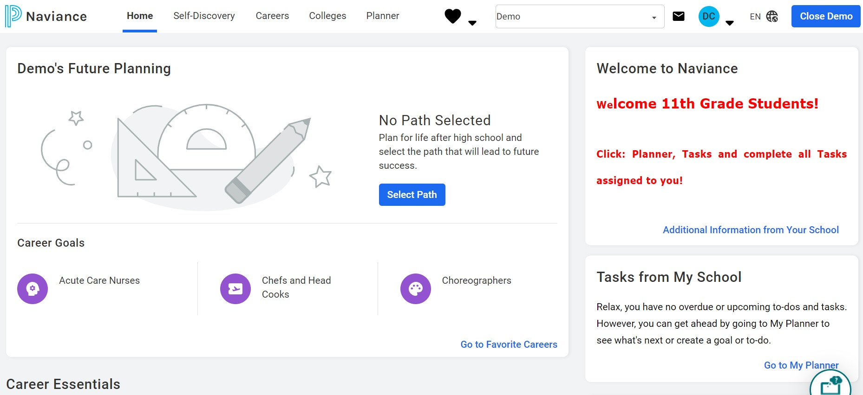
Naviance Student homepage
Notes:
This is the *NEW* Naviance home screen that students will see when they log in. Before beginning any activities, have the students click on "Select Path", review the pathways with them, and have them select their primary path. Students can also choose a secondary path if they are interested.

Slide 37
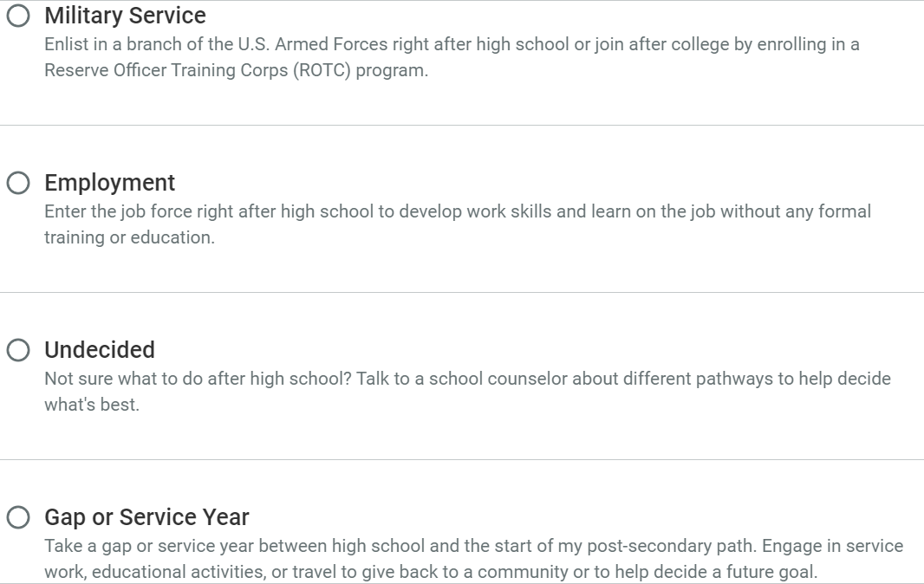
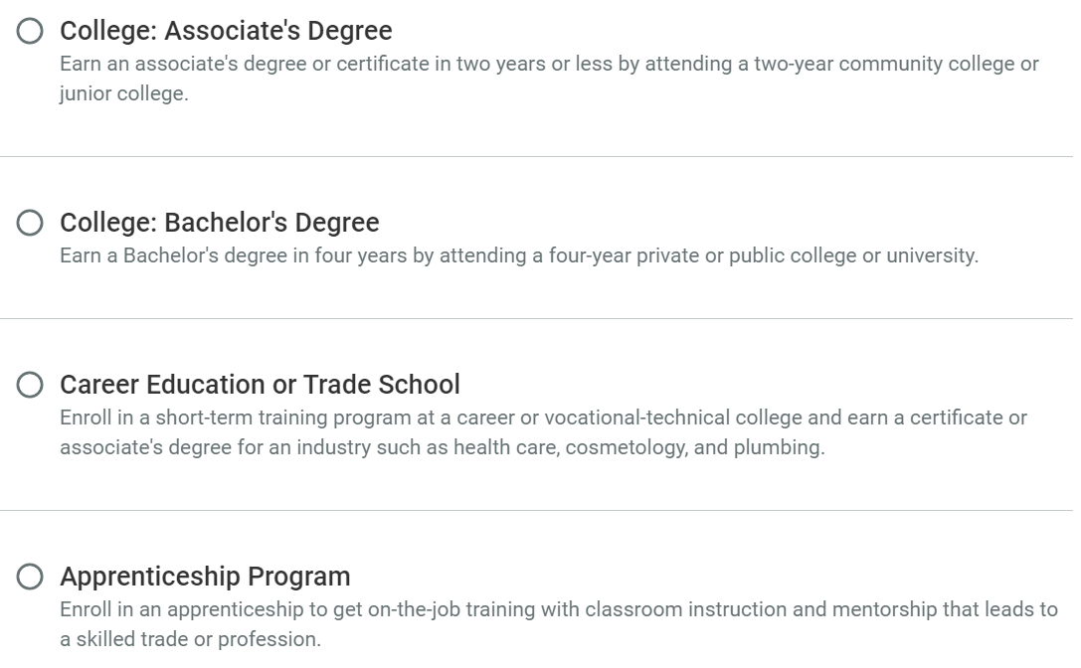
Select your path
YOU CAN ALSO CHOOSE A SECONDARY PATH IF YOU ARE STILL DECIDING!
Notes:
Choosing a path individualizes content on Naviance for each student. There are 8 pathway options:
College: Associate's Degree – earning a degree or certificate in 2 years (usually at a junior college or 2 year college)
College: Bachelor's Degree – earning a degree in 4 years by attending a private or public college or university
Career Education or Trade School – training programs usually at a technical college that earns you a certificate or associate's degree for an industry (e.g. health care, cosmetology, welding, plumbing)
Apprenticeship Program – on-the-job training (usually paid) that leads to a trade or profession
Military Service – enlisting in a branch of the military right after high school or joining after college (Army, Navy, Air Force, Marine Corps, Coast Guard, Space Force)
Employment – entering the work force right after high school with no formal training or education
Undecided – not sure yet
Gap or Service Year – taking a year off between high school and your post-secondary path (sometimes looks like volunteer or mission work depending on what your interests are)

Slide 38
Enter/update Your Email Address
We need your personal email address so we can communicate important information with you. Please get in the habit of checking email frequently.
Click on the “About Me” link at the top.
Click on “My Account.”
Click on the Pencil Icon in the “Contact Information Box.”
Enter your personal email address.
Click “Save.”
Notes:
Make sure students enter in their personal email and not CCSD email

Slide 39
You can use Naviance for…
College and Career Planning
Resume Building
Communicating with your Counselor
Scholarship Searches

Slide 40
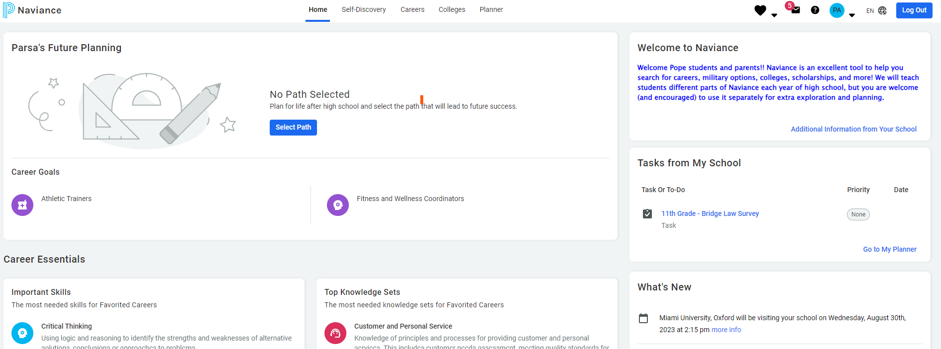
Bridge Law
On your dashboard home screen, tasks are on the right:

Slide 41
Complete the Junior Bridge Law Survey
Go to “My Planner” and click “Tasks”
Select: “11th Grade - BRIDGE Law Survey”
Select “take this survey” on the right side of the screen. Look for the pink diamond with a white arrow!
Click “Start”
Answer the questions and select “Save and Finish”

Slide 42
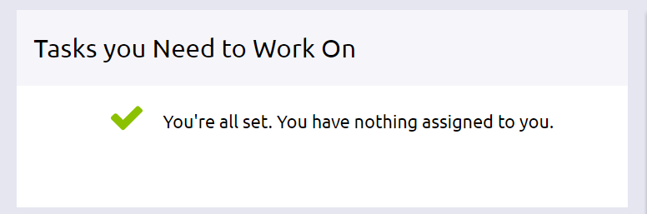
Don’t Log Out!
Wait for a counselor to confirm your completion
Go to “My Planner” and then “Tasks” to show completion status

Slide 43
“Plan for the future because that is where you are going to spend the rest of your life.” - Mark Twain
Something to think about…

