Slide 1
11th Grade
Bridge Law
SCHOOL Counseling Lesson
PEBBLEBROOK HIGH SCHOOL
991 Old Alabama Road SW
Mableton, Georgia 30126

Slide 2

PHS COUNSELORS

Slide 3
Today's LEARNING OBJECTIVEs
Students will: learn about college and career options (and the steps to achieve each option) in preparation for life after graduation.
Students will: plan for their final semesters of high school with the purpose of developing a viable post-graduation plan.

Slide 4
Let’s talk about…
Junior Advisement & IGP
Graduation Requirements and Options
Post-Secondary Options
HOPE Programs, Financial Aid, and Georgia MATCH
Naviance
Dual Enrollment

Slide 5
Junior advisement & igp

Slide 6
JUNIOR ADVISEMENT & INDIVIDUAL GRADUATION PLAN
The Individual Graduation Plan (IGP) will be completed in CSIS, using the link in your Naviance account.
All 11th grade students will receive advisement concerning remaining graduation requirements for their Senior year and post-graduation options during 2nd semester. More information to come!

Slide 7
Graduation requirements & options

Slide 8
Graduation requirements
Area of Study | Required Credits
English | 4 credits
Mathematics | 4 credits (Alg 1, Geometry, Adv Alg)
Science | 4 credits (Biology, Physics/Physical Science, Chem/Earth/Env Sci)
Social Studies | 3 credits (World, U.S., Gov/Econ)
World Language/CTAE/Fine Art | 3 credits
Personal Fitness/Health (or 3 units of JROTC) | 1.0 credit
General Electives | 4 credits
TOTAL CREDITS TO GRADUATE | 23
Students planning to meet the requirements of a four-year college/university must complete a minimum of two units of the same World Language and complete Math above Advanced Algebra/Algebra II (FoA does not meet that requirement).
Notes:
Emphasize the requirement for World Language and higher-level Mathematics for 4-Year College acceptance.

Slide 9
DUAL ENROLLMENT ACCELERATED CAREER DIPLOMA
If you are 100% sure you DO NOT want to attend a four-year college immediately after high school, and you’re interested in going directly into the workforce with a particular skill, this option may be for you (with parent approval).
Contact your assigned school counselor for more information if you are interested.
With only 9 required traditional high school credits, this option affords students the opportunity to simultaneously graduate with a CCSD high school diploma and Chattahoochee Technical College credentials.
Notes:
This is an alternate route toward high school graduation.

Slide 10
Dual enrollment accelerated career diploma high school requirements
American Literature and 1 additional English course
Algebra I and 1 additional Math course (Foundations of Algebra works!)
Biology and 1 additional Science course
Econ/Gov and United States History OR World History
Health and Personal Fitness
Completion of two technical certificates, one technical diploma or an Associate’s Degree

Slide 11
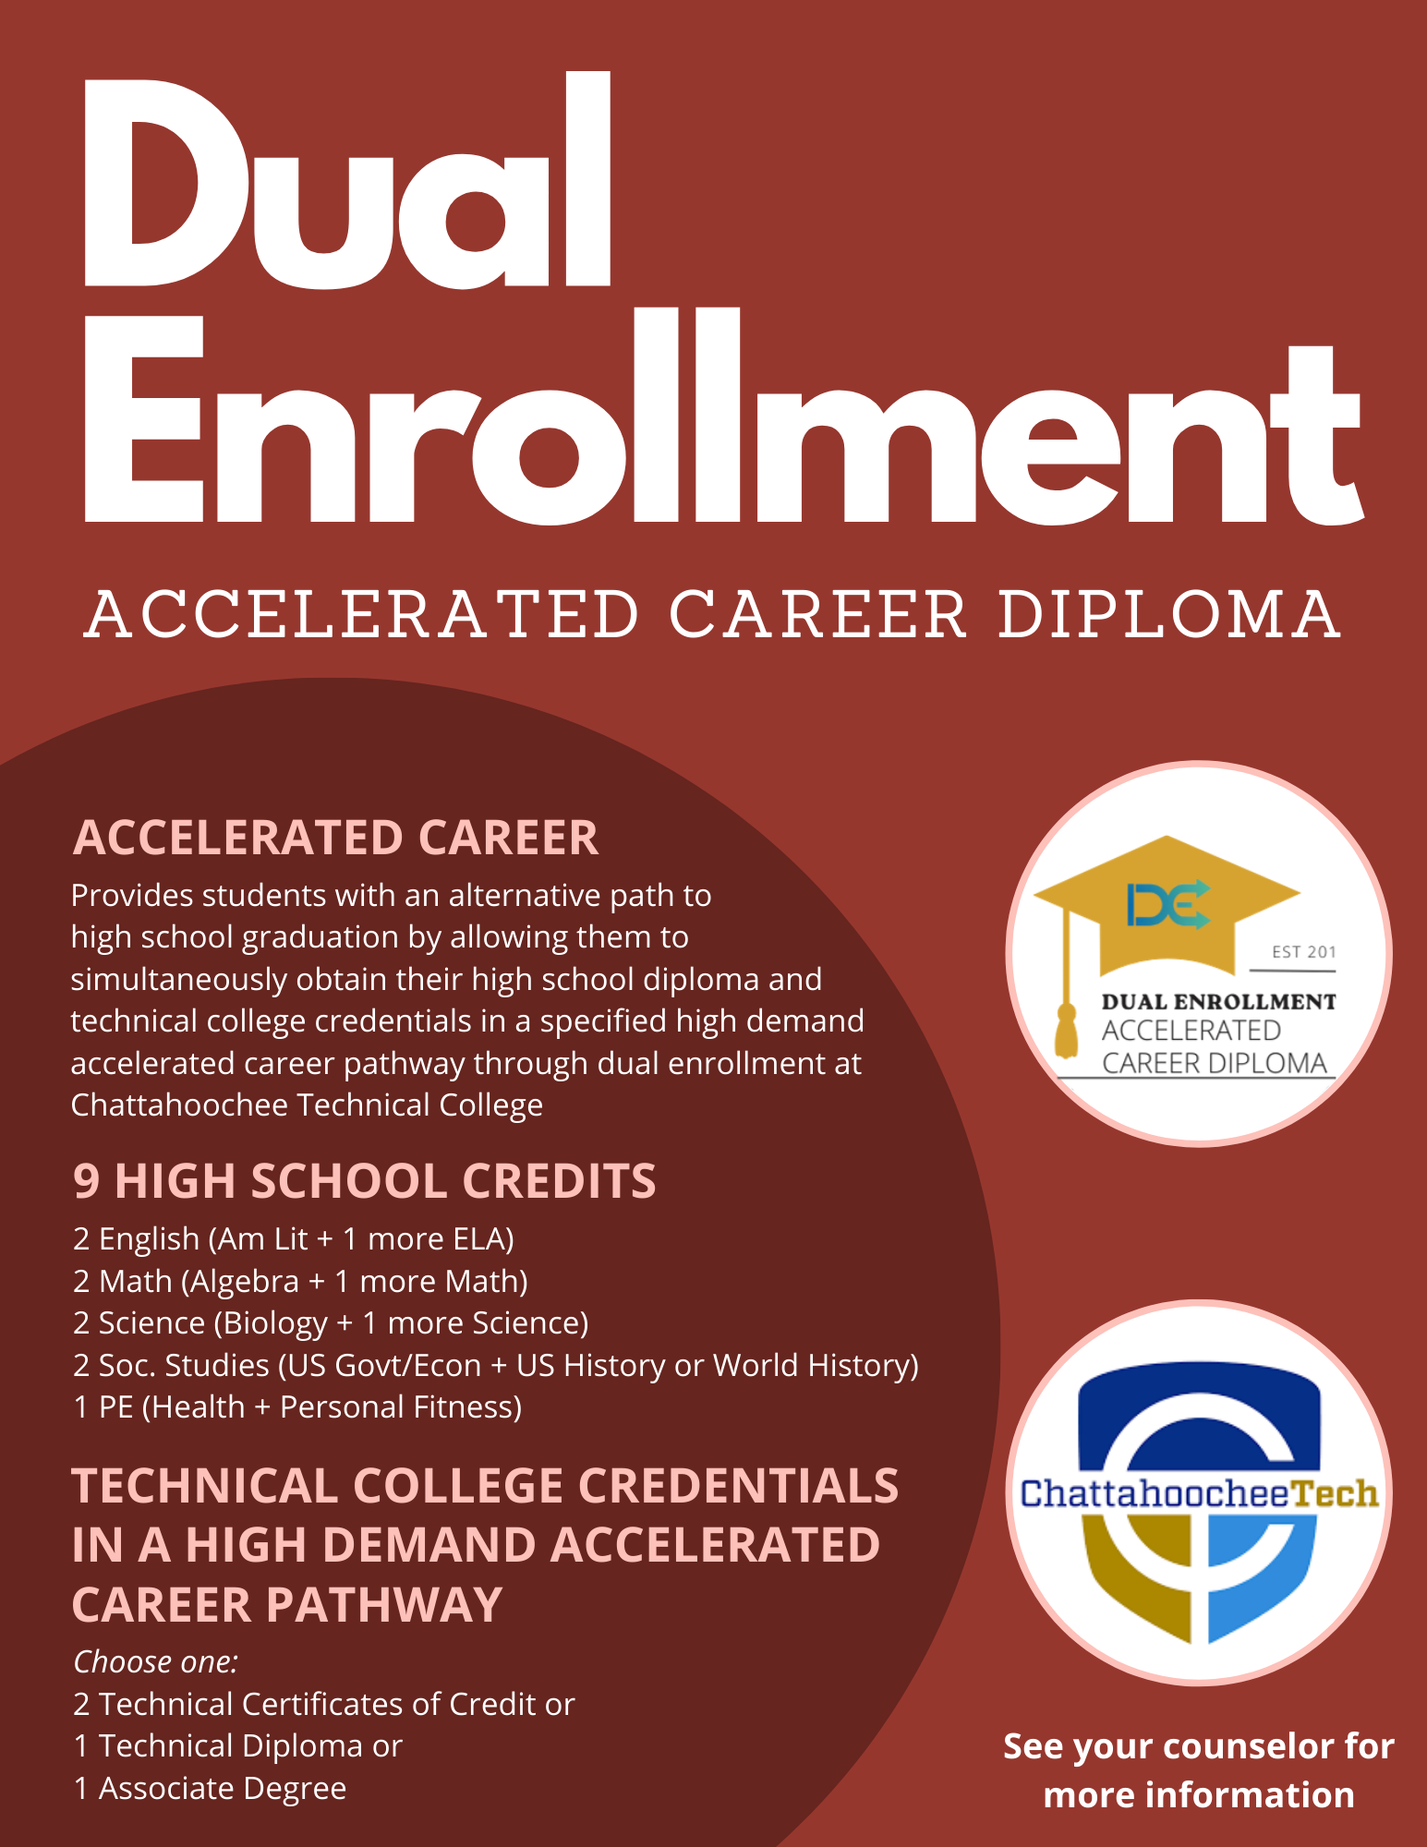

Chatt Tech
Accel Career Pathways

Slide 12
Phs counselors

Slide 13
DUAL ENROLLMENT

Slide 14
Dual Enrollment (DE)
Dual Enrollment (DE) is a program that allows 10th - 12th graders to take college classes while completing their high school diploma. Students receive high school credit towards graduation and receive the college credit.
DE pays for 100% tuition, mandatory fees, and required textbooks up to a maximum cap of 30 hours (this equates to roughly one year of full-time college enrollment or around 10 courses)
DE students can take approved courses in: English, math, science, social studies, or world/foreign languages AND/OR Career Tech (CTAE) classes.
The goal of DE is to increase college access and completion and prepare students to enter the workforce with the skills they need to succeed.
If you are interested in DE, please schedule an appointment with your assigned school counselor.

Slide 15
Interested in dual enrollment?
1. Contact your assigned school counselor to determine the process for scheduling a meeting to determine DE classes, complete paperwork, and inquire about deadlines set forth by your high school.
2. Research your DE college’s admissions requirements and deadlines
3. Apply to the college:
  Submit SAT/ACT/Accuplacer scores (take these ASAP!)
  Request official transcript from School Counseling office
4. Attend the scheduled meeting with your DE counselor (Mrs. Burnett) to make final decisions about DE classes and submission of required documents

Slide 16
dual enrollment considerations
Full-time or part-time participation
Whether your future college will accept transfer credits
DE vs. AP
Are you prepared for college-level classes?
Transportation and parking
Potential schedule complications, both in-school and extracurricular (especially for part-time participation)
CCSD and college calendars differ
  Exam dates, spring/fall/winter breaks will be different

Slide 17
PHS Counselors

Slide 18
Post-secondary options

Slide 19
What do I need to know?
What is my path after high school?
What are the requirements to get there?
What tests should I take?
How do I pay for it?

Slide 20
Post-secondary options
Apprenticeships and Job Training
Military
Specialty School
2-Year and/or Technical College
4-Year College/University
Other?
Notes:
On-the-job training: Short-term or long-term training is provided by an employer at the beginning of a new job
Military: 6-11 weeks of basic training when you join the Army, Navy, Air Force or the Marines
Specialty school: Enroll in schools like Full Sail, Nashville Diesel, Cordon Bleu, Paul Mitchell, etc.
Technical School: Enroll in a certificate or diploma program to prepare for a specific career
2-year community college: Earn an Associate’s degree or take courses that will transfer to a 4-year college/university
4-year college/university: Earn a Bachelor’s degree for a broad-based education and a specific education in a chosen subject area, or major

Slide 21


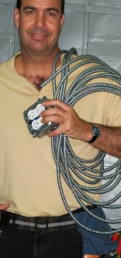

Trades and Apprenticeships
Occupations such as skilled construction work are considered trades or crafts.
The completion of an apprenticeship is generally associated with skilled labor. Training lasts 1 - 5 years, and provide on-the-job training, often paid. These kinds of programs can lead to secure and well-paying jobs. Additional education and training can provide high levels of advancement and increased salaries.
Notes:
Emphasize that there are some excellent and very well-paying careers that offer apprenticeships or on the job training. Most apprentices are paid while they work, reducing the burden of student loan debt and accelerating individuals into well paying and stable careers.
Counselors can lessen the information on the slides if needed for visual reasons but be sure to share all info!

Slide 22
Trade examples
Electrician
Contractor/Construction Manager
Plumber
Heating, Ventilation, and Air Conditioning (HVAC) Technician
Certified Cook
Firefighter
Automotive/Aviation Technician
Licensed Practical Nurse
Garden and Landscape Designer/Agriculture
Welder
Legal Assistant

Slide 23

State workforce development initiatives
HOPE Career Grant
The HOPE Career Grant can be the boost a student needs to get started on a rewarding career in a well-paying job, and without accumulating a lot of student debt. It also helps Georgia employers by creating a pipeline of skilled workers they can hire for the foreseeable future.
To be eligible for the HOPE Career Grant, students must first qualify for and be receiving the HOPE Grant. The two grants together will cover all tuition in these 17 programs of study.
  https://tcsg.edu/free-tuition/
  https://www.gafutures.org/hope-state-aid-programs/hope-zell-miller-grants/hope-career-grant/
Visit the following Linktree (or scan the QR code below) to learn more about several workforce development initiatives in Georgia – https://linktr.ee/GAWorkForceDevInitiatives
Notes:
In pairs or small groups, have students research and then share with the group about one of these state workforce development initiatives. Use the linktree QR code or link as listed to help their research

Slide 24
Hope grant + hope career grant = free tuition
These programs are high-demand careers that you can study at a Technical College for free!
You DO NOT need a specific GPA to get the HOPE Grant or HOPE Career Grant after high school.
Automotive Technology
Aviation Technology
Certified Engineer Assistant
Commercial Truck Driving
Computer Programming
Computer Technology
Construction Technology
Diesel Equipment Technology
Early Childhood Care and Education
Electrical Lineman Technology
Health Science
Industrial Maintenance
Logistics/Transportation Technology
Movie Production Set Design
Practical Nursing
Precision Manufacturing
Welding and Joining Technology
Learn more at https://tcsg.edu/free-tuition

Slide 25




Apprenticeships and workforce
On-the-job training
Provided by employer
Related to skilled labor and training for actual jobs
Can lead to higher-paying secure jobs

Slide 26
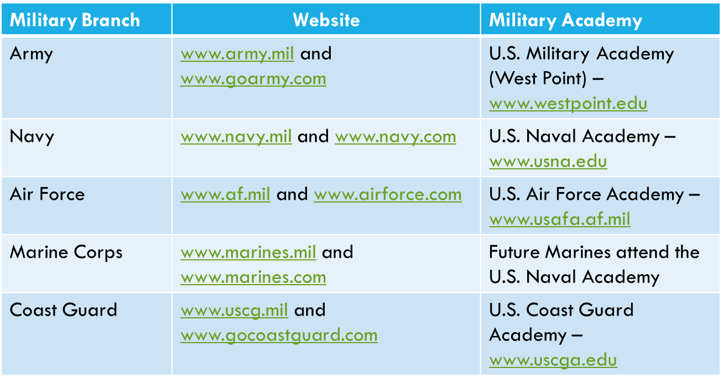
Military and military academies
Take the ASVAB for career placement and branch eligibility.
Military academy appointments are highly competitive, and students accepted attend tuition-free.

Slide 27
What does “college” mean?
After high school, you have many paths to college or career training.
Specialty School
Certificate or diploma
Technical or 2-year college
Certificate
Associate’s Degree
4-year College or University
Bachelor’s Degree (and beyond)
Notes:
To add more engagement, include a reflection question like: Which college path fits your goals right now? Explain why.

Slide 28
Hs graduation vs. college: understanding the difference
High School Graduation
College Admissions
Requirements are set by the GA Department of Education (GaDOE)
Tracked by you, your teachers, and your school counselor
Meeting requirements = HS graduation guaranteed
23 credits required in specific areas
Foundations of Algebra counts as 4th math credit
World Language is not required.
Requirements set by each college or university
Tracked by you—check what each college/university needs
Meeting minimum requirements does not guarantee acceptance
Requires standardized testing (e.g., SAT, ACT, Accuplacer
4-year colleges/universities require math beyond Advanced Alg/Alg 2
2 credits of the same World Language recommended or required (e.g., Spanish 1 and Spanish 2; French 1 and French 2)
Notes:
Talking points:
Meeting minimum admissions requirements does not guarantee admissions
Refer to freshman profile on college websites
College admissions requirements are often greater than graduation requirements (even in GA)
It is the student’s responsibility to know the college admissions requirements

Slide 29
How do I get into college?
Explore your options and find the right fit for YOU!
Research and Explore
  Research colleges and universities online
  Attend college fairs and information sessions
  Schedule virtual or in-person college visits
  Explore majors and careers using Naviance
Build Your List
  Add colleges to “Colleges I’m Thinking About” in Naviance
  Use the SuperMatch in Naviance to compare schools
  Consider location, size, majors, cost, and campus life
  Keep track of application deadlines and requirements
Understand Requirements
  Review Freshman Profile for GPA and test score averages
  Learn about application types (e.g., Common App, Coalition, direct from college website)
  Check if your schools are test-optional or test-required
  Review essay and letters of recommendation requirements early
Prepare to Apply
  Keep grades strong
  Take or retake standardized tests (e.g., SAT, ACT, Accuplacer)
  Create a resume or brag sheet for letters of recommendation
Find Balance
  Apply to 5-7 schools
  Include Safety, Target, and Reach schools
Notes:
Talking points:
Include in your list of potential schools:
reach(dream) school – student’s core GPA and test scores are below the college’s freshman profile OR the school is highly competitive
target schools – student’s core GPA and test scores match the college’s freshman profile
safety schools – student’s core GPA and test scores are above the college’s freshman profile
Online resources include: GAfutures, Big Future (College Board), etc.
Remind students to use Naviance often as it helps them to stay organized and confident about their next step(s).

Slide 30
Application process: what you need to know
Timing Matters
  Apply during Senior year
  Your transcript shows grades through Junior year—finish strong!
  Know your deadlines—they are firm.
What You Will Need
  Online application
  Official transcript (sent by counselor)
  Test scores—sent directly from College Board or ACT
  Application fee (fee waivers available for students on free/reduced lunch)
  Recommendations (only if required)
    Counselor Recommendation or school evaluation
    Teacher Recommendation
Quick Tips
  Keep track of login information and deadlines
  Check your email often for application updates
  Ask for recommendations at least
Notes:
Talking points:
Include in your list of potential schools:
reach(dream) school – student’s core GPA and test scores are below the college’s freshman profile OR the school is highly competitive
target schools – student’s core GPA and test scores match the college’s freshman profile
safety school – student’s core GPA and test scores are above the college’s freshman profile
Recommendations:
The teacher recommendation should usually be from a core teacher
Explain your school’s counselor recommendation policy
Deadlines: These are firm. Tell kids not to wait until the last minute because servers do go down and postal workers strike.
Reiterate that counselors do not send test scores
Consider using an engagement prompt question like: Have you added the colleges/universities you’re interested to the “Colleges I’m Applying To” list in Naviance?

Slide 31
College entrance exams: sat vs. act
Most colleges and universities accept both tests.
SAT
  Focuses on reasoning, analysis, and problem-solving
  2 sections: Math and Reading
  No penalty for guessing
  Score range: 400-1600
  Free online practice (e.g., Khan Academy)
  Website: www.sat.org
ACT
  Questions feel more like standard high school tests
  4 sections: English, Math, Reading, Science (+ optional Writing)
  No penalty for guessing
  Score range: 1-36
  Free online practice (e.g., ACT Academy)
  Website: www.actstudent.org
Test registration is through the SAT and ACT websites; not the high school or college. Most colleges will accept either test. Writing requirement varies by college. These tests are sometimes required for admissions to 4-year colleges and universities. Students can take BOTH. Students who receive Free or Reduced Lunch qualify for fee waivers. Please contact your school counselor if you think you qualify for a waiver.
Notes:
Talking points:
How do I register for these tests?
ACT will look more like tests they have taken before
SAT is a reasoning test
Go to Gafutures.org for more information

Slide 32
Other tests you may need
ACCUPLACER – Placement exam for two year and technical colleges. (Schedule to take this test at chosen college)
ASVAB – Aptitude/career exam required for entrance into the military that determines your eligibility for military jobs
It is the student’s responsibility to check with each individual college for all admission requirements.
Notes:
If offered by your school, taking the ASVAB on campus is a great idea because you do not have to report the scores. It gives students a chance to “preview” the exam before taking it at MEPS.

Slide 33
PHS COUNSELORS

Slide 34
Hope, financial aid, & GA Match

Slide 35
Hope scholarship vs. hope grant: what’s the difference?
HOPE Scholarship
For students earning a college degree (2-year or 4-year)
Must have a 3.0 core GPA (as calculated by GSFC)
  Can also be earned in college
Earn a minimum of 4 credits from the Academic Rigor List prior to high school graduation
  Click HERE to access the list.
Must graduate from a GA high school
Must be a GA resident for at least one year (Green card or citizenship)
HOPE Grant
For students pursuing a technical diploma or certificate
No GPA requirement to start
  Must maintain a 2.0 GPA after 30 credit hours
Must have a HS diploma or GED
Must be a GA resident for at least one year (Green card or citizenship)
Apply for HOPE by completing the FAFSA. Go to www.gafutures.org for more information on requirements and award amounts.
Notes:
Talking points:
Technical colleges offer two-year degrees as well as certificates and diplomas
Some technical certificates consist of core college courses so a student could obtain the certificate and then transfer credits to apply toward a two-or four-year degree.
Give students a copy of the included flyer on where to check their HOPE GPA on Ga Futures. Free copies can be ordered from Georgia Student Finance Commission at:
https://www.gsfc.org/gheac/order_loan/index.cfm?guid=&returnurl=https%3a%2f%2fsecure.gacollege411.org%2fHome%2fEducator.aspx

Slide 36

Zell miller scholarship information
3.7 core GPA as calculated by GSFC (www.gafutures.org)
1200 on the SAT or 25 on the ACT
Must earn a minimum of 4 credits from the academic rigor course list prior to high school graduation. (Review your HOPE transcript on GAfutures.org)
Must graduate from a GA high school
Must be a GA resident for at least one year (Green Card or citizenship)
Go to GAfutures for more information on requirements and award amounts

Slide 37
Building your hope gpa: what counts
HOPE includes your core academic courses—not every elective.
All classes that begin with the following numbers:
  23.xx: English
  27.xx: Math
  26.xx: Science
  40.xx: Science
  45.xx: Social Studies
  60.xx-64.xx: World Languages
  Additional courses approved for 4th year of science (e.g., Computer Science)
HOPE Reminders:
HOPE counts required + academic elective courses.
Review your HOPE GPA and rigor courses at GAfutures.org.
Check your high school HOPE GPA each year.
Notes:
Explain the course numbers using the first two digits of the course number so students understand that required courses and electives count for HOPE. See handout regarding rigor requirements.
Certain CTAE courses will count in the HOPE GPA as the fourth year of science.
High school credit earned in middle school does not count toward HOPE – only specific courses completed in grades 9-12 will count toward HOPE GPA.

Slide 38
Weighted courses: what counts toward hope
Honors courses do not earn additional quality points toward the HOPE GPA.
AP, IB, and Dual Enrollment core courses earn .5 additional quality points, but will not exceed a 4.0.
It is the student’s responsibility to track HOPE eligibility on GAfutures.org.
  If you are interested in the HOPE scholarship program, be sure to create your GAfutures account so you can track your HOPE eligibility.

Slide 39
YOUR HOPE GPA IS NOT ON YOUR CCSD TRANSCRIPT!
MONITOR YOUR HOPE GPA on GAfutures.org

Slide 40
Look out for your georgia match letter
Georgia MATCH is a statewide initiative that gives Georgia high school seniors a personalized list of colleges and universities at which they meet initial academic eligibility.
    It uses the junior year HOPE GPA to show a personalized list of colleges and technical schools across Georgia.
    Students will receive a letter and can access the information through the Student Dashboard on their GAfutures account. Students must have a GAfutures account to view this information.
    Students may request more information about matched colleges through their student account in GAfutures.
    Students can see where they qualify before applying.
    Some schools may offer fee waivers when applying through Georgia MATCH.
Notes:
Reiterate that this information will come in Senior Year and cannot be accessed at this time. This is just to give them a heads up. Encourage students to go to GAfutures for more information.

Slide 41
WAYS TO PAY FOR COLLEGE
SOURCE
Family Savings
Grants and Scholarships
  Based on specific requirements
  Does not have to be repaid
Loans
  Must be repaid after college (with interest)
Work-study Programs
  Student has a job on campus.
ADDITIONAL INFORMATION
Financial aid requirements are different for undocumented students.
There may be additional options as provided by the specific college.
It is the student’s responsibility to contact the college directly.

Slide 42
Paying for college: let’s talk money
Family Savings
Money saved by you or your family to help cover college costs.
529 Plan: a college savings account that helps families save money for education, tax-free.
Grants & Scholarships
Based on specific requirements
Do NOT have to be repaid
Includes HOPE, Zell Miller, etc.
Loans
Borrowed money that must be repaid after college (with interest)
Offered by federal and private lenders
Work-Study Programs
Earn money by working part-time on campus
Helps reduce loan amounts
Important Notes
Financial aid rules may differ for undocumented students.
Some colleges offer additional financial aid options—always check the college’s website.
It is the student’s responsibility to contact

Slide 43
Free money 101: how to find scholarships that pay
Where do I find resources?
How do I get the money?
School Counseling office and/or Career Center
College websites
Online resources like GAfutures, Naviance, BigFuture (College Board), etc.
Current employer or family’s employer
Community
Organizations in which you may be involved
Create a resume and prepare a personal statement so you will be ready to apply
Search for scholarships everywhere
Apply early and often—remember, scholarships have deadlines too!
Complete the FAFSA as soon as possible during Senior year. Student grants, loans, and work study are awarded through the FAFSA.

Slide 44
naviance
Notes:
Talking Point(s):
-Naviance is a delivery system and college and career search engine, but it is also how we communicate with YOU and your parents throughout the year.

Slide 45
Logging into Naviance
If you are using a CCSD computer, you will be automatically logged into Naviance.
You can access Naviance from the CCSD homepage, your school’s website, as well as your school counseling department’s website.
To log into Naviance from home, you will use the following:
User Name: | Password:
Microsoft 365 Username | Microsoft 365 Password

Slide 46
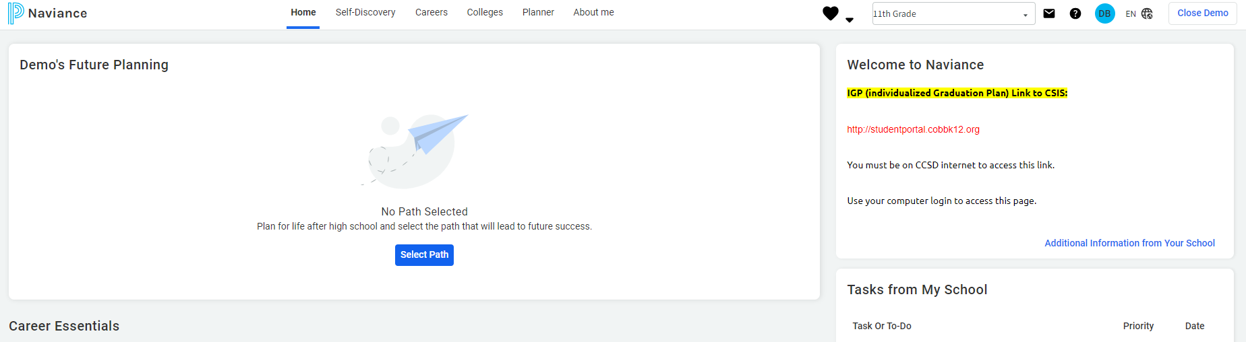
Naviance student homepage
Notes:
This is the *NEW* Naviance home screen that students will see when they log in. Before beginning any activities, have the students click on "Select Path", review the pathways with them, and have them select their primary path. Students can also choose a secondary path if they are interested.

Slide 47
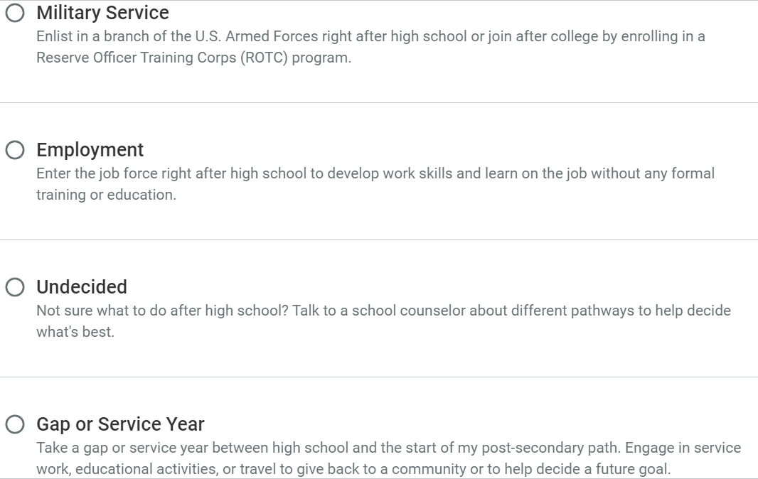
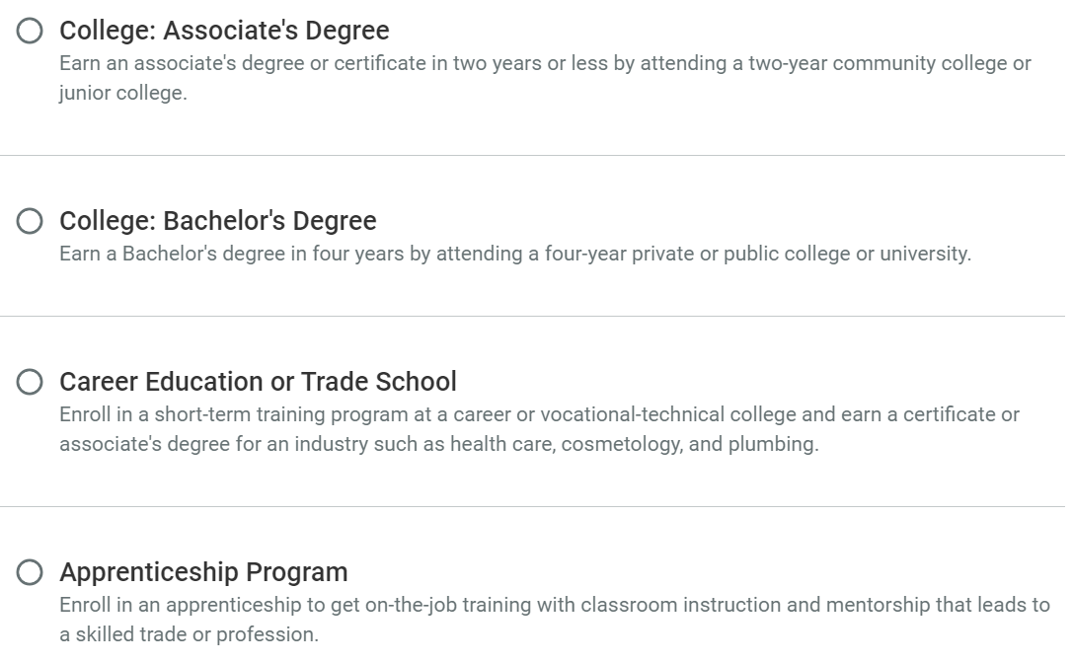
Select your path
If you are still exploring your options, you can choose a secondary path to keep your options open.
Notes:
Choosing a path individualizes content on Naviance for each student. There are 8 pathway options:
College: Associate's Degree – earning a degree or certificate in 2 years (usually at a junior college or 2 year college)
College: Bachelor's Degree – earning a degree in 4 years by attending a private or public college or university
Career Education or Trade School – training programs usually at a technical college that earns you a certificate or associate's degree for an industry (e.g. health care, cosmetology, welding, plumbing)
Apprenticeship Program – on-the-job training (usually paid) that leads to a trade or profession
Military Service – enlisting in a branch of the military right after high school or joining after college (Army, Navy, Air Force, Marine Corps, Coast Guard, Space Force)
Employment – entering the workforce right after high school with no formal training or education
Undecided – not sure yet
Gap or Service Year – taking a year off between high school and your post-secondary path (sometimes looks like volunteer or mission work depending on what your interests are)

Slide 48
Enter/update Your
Email Address
We need your personal email address so we can communicate important information with you. Be sure to check your email regularly—that’s where you will receive important information.
Click on the “About Me” link at the top.
Click on “My Account.”
Click on the Pencil Icon in the “Contact Information Box.”
Enter your personal email address.
Click “Save.”
Notes:
Make sure students enter in their personal email and not CCSD email

Slide 49
You can use Naviance for…
College and Career Planning
Resume Building
Communication with your Counselor
Scholarship Searches

Slide 50
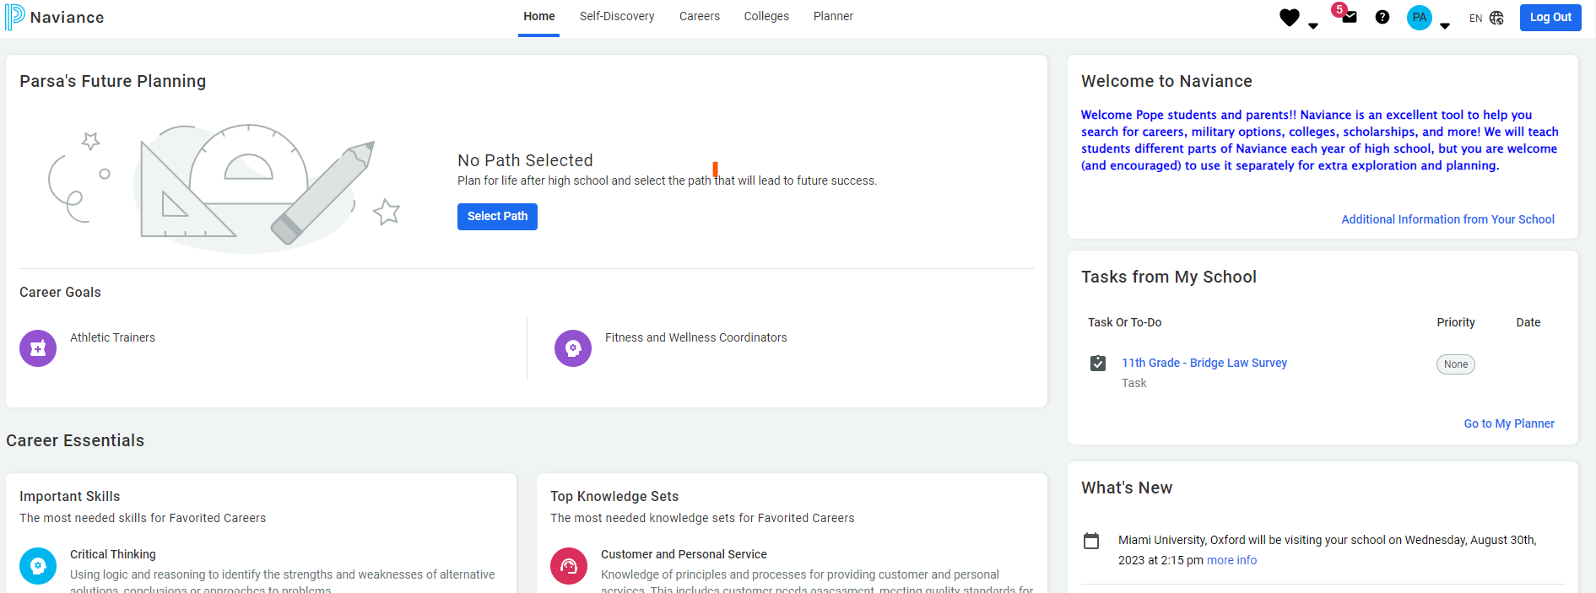
Bridge Law
On your dashboard, your assigned task(s) are listed under Tasks from My School.

Slide 51

Complete the Junior Bridge Law Survey
Go to My Planner and click Tasks
Select 11th Grade - BRIDGE Law Survey
Select take this survey on the right side of the screen. Look for the pink diamond with a white arrow.
Click Start
Answer the questions and select Save and Finish

Slide 52
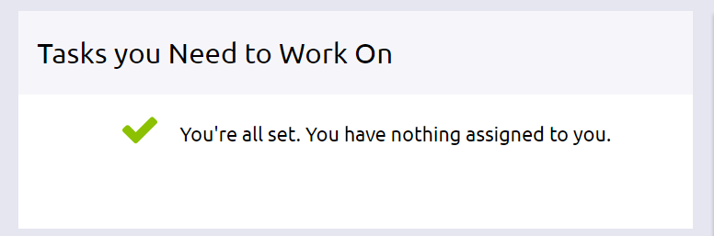
Don’t Log Out!
Please wait for a counselor to confirm your completion
Go to My Planner and then Tasks to show completion status

Slide 53
PHS COUNSELORS

Slide 54
“The best way to predict the future is to create it.”
-Abraham lincoln

