Slide 1
11th Grade Student/parent information session
PEBBLEBROOK HIGH SCHOOL

Slide 2
Who is your school counselor?
Mr. Corey Tinsley (A – DE)
Dr. Aleesa Reese (DF – JO)
Mr. Patrick Burch (JP – RE)
Ms. Julynn Williams-Chandler (RF - Z), Counseling Department Chair
Mrs. Karen Grannis (ESOL/IEL)
Mrs. Schloemer Bryant (CCCEPA)
Mrs. Dionne Burnett (GRASP)
Notes:
Please insert department information on this slide.

Slide 3
LEARNING OBJECTIVE
Students will learn about college and career options (and the steps to achieve each option) in preparation for life after graduation.

Slide 4
Let’s talk about…
Junior Advisement & IGP
Graduation Requirements and Options
Post-Secondary Options
HOPE Programs, Financial Aid, and Georgia Match
Naviance
Dual Enrollment

Slide 5
JUNIOR ADVISEMENT & IGP

Slide 6
JUNIOR ADVISEMENT & INDIVIDUAL GRADUATION PLAN
The Individual Graduation Plan (IGP) will be completed in CSIS, using the link in Naviance.
All 11th grade students will receive advisement concerning remaining graduation requirements for their Senior year and post-graduation options during 2nd semester. More information to come!

Slide 7
Graduation requirements

Slide 8
Graduation requirements
Area of Study | Required Credits
English | 4 credits (9th Lit, American Lit)
Mathematics | 4 credits (Alg, Geometry, Adv Alg)
Science | 4 credits (Biology, Physics/Physical Science, Chem/Earth/Env Sci, AP/IB)
Social Studies | 3 credits (World, U.S., Gov/Econ)
World Language/CTAE/Fine Art | 3 credits
Personal Fitness/Health (or 3 units of JROTC) | 1.0 credit
General Electives | 4 credits
TOTAL CREDITS TO GRADUATE | 23
Students planning to meet the requirements of a four-year college/university must complete a minimum of two units of the same World Language and complete Math above Advanced Algebra/Algebra II (FoA does not meet that requirement)
Notes:
Emphasize the requirement for World Language and higher-level Mathematics for 4-Year College acceptance.

Slide 9
DUAL ENROLLMENT

Slide 10
Dual Enrollment (DE)
Dual Enrollment is a program that allows 10th - 12th graders to take college classes while completing their high school diploma. Students receive high school credit towards graduation and receive the college credit.
DE pays for 100% tuition, mandatory fees, and required textbooks up to a maximum cap of 30 hours (this equates to roughly one year of full-time college enrollment or around 10 courses)
DE students can take approved courses in: English, math, science, social studies, or foreign languages and/or Career Tech classes.
If you’re interested in Dual Enrollment, make an appointment with Mrs. Burnett
Notes:
Each school can edit the 5th bullet to add their school-specific next steps for interested students (i.e., talk to counselor, attend information session, etc.)
Counselors can lessen the information on the slide for visual purposes but be sure to share all info.
Here are the benefits to DE – you can present these to your students as appropriate:
Introduces students to college-level coursework.
• Earning college credits while still in high school may enable students to graduate early
and/or possibly even earn an associate degree, diploma or certificate.
• Helps students adjust to certain aspects of the college experience (e.g., classes, coursework,
and instruction, being on a college campus) so the transition from high school to college may
be easier.
• Students who participate in a dual enrollment program are more likely to go to college and
get a college degree.
• Students may be able to take classes that are not offered at their high school, especially in
subject areas they are interested in for a potential career.
• Participating in a dual enrollment program demonstrates a student’s ability to handle more
difficult coursework which is something college admissions officers may look upon favorably
during admissions and recruiting.
• Taking college-level classes while still in high school may build confidence and encourage
those students who may not be thinking about college to reconsider.
DE yields college credit upon successful completion of the course as opposed to AP courses in which students are only awarded college credit with a qualifying AP Exam score.

Slide 11
Interested in dual enrollment?
Mrs. Burnett is the Dual Enrollment counselor. You will be required to attend an information session prior to participating. For more information, visit Dual Enrollment | proudphscounselors
Just a few things to consider:
Full-time or part-time participation
Whether your future college will accept transfer credits
How your future college might compare DE vs. AP
Are you ready for college level classes?
Transportation and parking
Potential schedule complications, both in-school and extracurricular (especially for part-time participation)
Cobb County and college calendars are different — exam dates, spring/fall/winter breaks will be different

Slide 13
Post-secondary options

Slide 14
What do I need to know?
What is my path after high school?
What are the requirements to get there?
What tests should I take?
How do I pay for it?

Slide 15
Post-secondary options
Apprenticeships and Job Training
Military
Specialty School
2-Year and/or Technical College
4-Year College/University
Other?
Notes:
On-the-job training: Short-term or long-term training is provided by an employer at the beginning of a new job
Military: 6-11 weeks of basic training when you join the Army, Navy, Air Force or the Marines
Specialty school: Enroll in schools like Full Sail, Nashville Diesel, Cordon Bleu, Paul Mitchell, etc.
Technical School: Enroll in a certificate or diploma program to prepare for a specific career
2-year community college: Earn an Associate’s degree or take courses that will transfer to a 4-year college/university
4-year college/university: Earn a Bachelor’s degree for a broad-based education and a specific education in a chosen subject area, or major

Slide 16
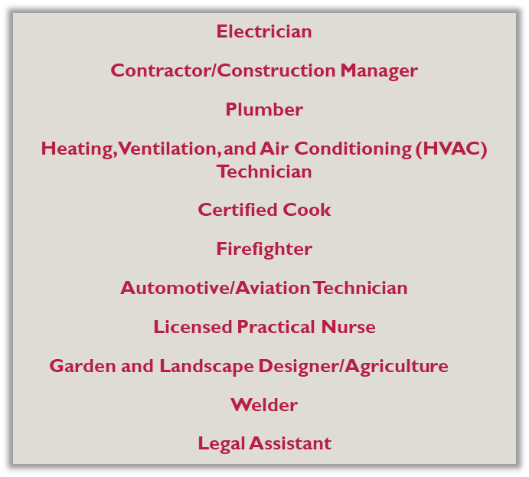
Trades and Apprenticeships
The completion of an apprenticeship is generally associated with skilled labor. Training lasts 1 - 5 years, and provide on-the-job training, often paid. These kinds of programs can lead to secure and well-paying jobs. Additional education and training can provide high levels of advancement and increased salaries.
Notes:
Emphasize that there are some excellent and very well-paying careers that offer apprenticeships or on the job training. Most apprentices are paid while they work, reducing the burden of student loan debt and accelerating individuals into well paying and stable careers.
Counselors can lessen the information on the slides if needed for visual reasons but be sure to share all info!

Slide 17
HOPE Grant + HOPE CAREER GRANT = FREE TUITION
These programs are in High Demand and can be studied at a Technical College Tuition Free.
There is no GPA requirement to earn the HOPE Grant and HOPE Career Grant out of high school!
Automotive Technology
Aviation Technology
Certified Engineer Assistant
Commercial Truck Driving
Computer Programming
Computer Technology
Construction Technology
Diesel Equipment Technology
Early Childhood Care and Education
Electrical Lineman Technology
Health Science
Industrial Maintenance
Logistics/Transportation Technology
Movie Production Set Design
Practical Nursing
Precision Manufacturing
Welding and Joining Technology
Learn more at https://tcsg.edu/free-tuition

Slide 18
Military and Military Academies
Military Branch | Website | Military Academy
Army | www.army.mil and www.goarmy.com | U.S. Military Academy (West Point) – www.westpoint.edu
Navy | www.navy.mil and www.navy.com | U.S. Naval Academy – www.usna.edu
Air Force | www.af.mil and www.airforce.com | U.S. Air Force Academy – www.usafa.af.mil
Marine Corps | www.marines.mil and www.marines.com | Future Marines attend the U.S. Naval Academy
Coast Guard | www.uscg.mil and www.gocoastguard.com | U.S. Coast Guard Academy – www.uscga.edu
Speak with a recruiter to learn about opportunities available in the military.
Excellent scholarships are available for students who pursue ROTC in college.
Take the ASVAB for career placement and branch eligibility.
Military academy appointments are highly competitive, and students accepted attend completely FREE.

Slide 19
What does “College” mean?
Specialty School (certificate or diploma)
2-year and/or Technical College (certificate, diploma or Associate’s degree)
4-year College/University (Bachelor’s degree)
There are several types of schools someone with a high school diploma can attend to earn an undergraduate degree or certificate.

Slide 20
How do I get into college?
Research colleges and universities online
Attend college fairs and info sessions
Make a list of potential schools
Schedule college visits (virtual and in-person) when possible
Build your list
Add interested colleges to “Colleges I’m Thinking About” in Naviance
Define Your Priorities
Location, Size, Major, Cost
Look at Freshman Profile
Admission Requirements
Do Your Research
SuperMatch in Naviance
Find Balance
5-7 colleges
Safety, Target, and Reach colleges
Notes:
Talking points:
Include in your list of potential schools:
reach(dream) school – student’s core GPA and test scores are below the college’s freshman profile OR the school is highly competitive
target schools – student’s core GPA and test scores match the college’s freshman profile
safety schools – student’s core GPA and test scores are above the college’s freshman profile
Online resources include: GAfutures, Big Future (College Board), etc.

Slide 21
Application Process: what you need to know
Apply during your Senior year
Remember: Your transcript will reflect your grades and coursework through Junior year. As always, do your best in all courses!
Review each school’s application:
Online application or Common App
Transcript
Test scores (send directly from ACT or College Board)
Application fee (fee waiver for free/reduced lunch students)
Recommendations (only if required by the college)
Counselor Recommendation (or school evaluation)
Teacher Recommendation (letter or form, typically a core teacher)
Know the deadlines! They are firm!
Notes:
Talking points:
Include in your list of potential schools:
reach(dream) school – student’s core GPA and test scores are below the college’s freshman profile OR the school is highly competitive
target schools – student’s core GPA and test scores match the college’s freshman profile
safety school – student’s core GPA and test scores are above the college’s freshman profile
Recommendations:
The teacher recommendation should usually be from a core teacher
Explain your school’s counselor recommendation policy
Deadlines: These are firm. Tell kids not to wait until the last minute because servers do go down and postal workers strike.
Reiterate that counselors do not send test scores

Slide 22
College entrance exams: SAT v. act
SAT
www.sat.org
Questions often require application, reasoning and analysis.
2 sections: Math and Reading
No penalty for guessing
1600 maximum score
Free online practice: Khan Academy
ACT
www.actstudent.org
More straight-forward questions like those you may have seen on high school assessments
4 sections: Math, English, Science, Reading and optional Writing
No penalty for guessing
36 maximum score
Free online practice: ACT Academy
Test registration is through the SAT and ACT websites; not the high school or college. Most colleges will accept either test. Writing requirement varies by college. These tests are sometimes required for admissions to 4-year colleges and universities. Students can take BOTH. Students who receive Free or Reduced Lunch qualify for fee waivers. Please contact your school counselor if you think you qualify for a waiver.
Notes:
Talking points:
How do I register for these tests?
ACT will look more like tests they have taken before
SAT is a reasoning test
Go to Gafutures.org for more information

Slide 23
Other tests I may need
ACCUPLACER – Placement exam for two year and technical colleges. (Schedule to take this test at chosen college)
ASVAB – Aptitude/career exam required for entrance into the military that determines your eligibility for military jobs
It is the student’s responsibility to check with each individual college for all admission requirements.
Notes:
If offered by your school, taking the ASVAB on campus is a great idea because you do not have to report the scores. It gives students a chance to “preview” the exam before taking it at MEPS.

Slide 24
Hope, financial aid, & GA Match

Slide 25
Hope information
HOPE Scholarship
3.0 core GPA as calculated by the GSFC (www.gafutures.org)
Can be earned in college
Must earn a minimum of 4 credits from the academic rigor course list prior to graduating from high school. (Review your HOPE transcript on GAfutures.org)
Two-year or four-year degree
Must graduate from a GA high school
Must be a GA resident for at least one year (Green Card or citizenship)
HOPE Grant
No initial GPA requirement
2.0 GPA required after the first 30 credit hours
Technical certificate or diploma
Must have a high school diploma or GED
Must be a GA resident for at least one year (Green Card or citizenship)
Apply for HOPE by completing the FAFSA. Go to www.gafutures.org for more information on requirements and award amounts.
Notes:
Talking points:
Technical colleges offer two-year degrees as well as certificates and diplomas
Some technical certificates consist of core college courses so a student could obtain the certificate and then transfer credits to apply toward a two-or four-year degree.
Give students a copy of the included flyer on where to check their HOPE GPA on Ga Futures. Free copies can be ordered from Georgia Student Finance Commission at:
https://www.gsfc.org/gheac/order_loan/index.cfm?guid=&returnurl=https%3a%2f%2fsecure.gacollege411.org%2fHome%2fEducator.aspx

Slide 26
Zell miller scholarship information
3.7 core GPA as calculated by GSFC (www.gafutures.org)
1200 on the SAT or 25 on the ACT
Must earn a minimum of 4 credits from the academic rigor course list prior to graduating from high school. (Review your HOPE transcript on GAfutures.org)
Must graduate from a GA high school
Must be a GA resident for at least one year (Green Card or citizenship)
Go to www.gafutures.org for more information on requirements and award amounts

Slide 27
What classes count toward hope?
Core classes, academic electives, world/foreign language courses
All classes that begin with the following numbers:
English
Mathematics
Science
Science
Social Studies
World Languages
Additional courses approved for fourth year of science (such as computer science)
Review course list at www.gafutures.org.
Review HOPE rigor requirements at www.gafutures.org
Notes:
Explain the course numbers using the first two digits of the course number so students understand that required courses and electives count for HOPE. See handout regarding rigor requirements.
Certain CTAE courses will count in the HOPE GPA as the fourth year of science.
High school credit earned in middle school does not count toward HOPE – only specific courses completed in grades 9-12 will count toward HOPE GPA.

Slide 28
Which Courses are Weighted for HOPE?
Honors courses do not earn additional quality points toward the HOPE GPA.
AP, IB, and Dual Enrollment core courses earn .5 additional quality points, but will not exceed a 4.0.
It is your responsibility to track HOPE eligibility on Gafutures.org. If you have not created an account and you are interested in the HOPE Scholarship program, we suggest that you create an account as soon as possible.

Slide 29
YOUR HOPE GPA IS NOT ON YOUR CCSD TRANSCRIPT!!!!
MONITOR YOUR HOPE GPA on www.gafutures.org

Slide 30
Look out for Georgia Match (fall of Senior year)
Georgia Match is a program that matches Seniors with Georgia colleges for which the student meets the current Freshman Index based upon the Junior Year HOPE GPA.
Students will receive a letter and can access the information through their GAfutures account, provided they created an account.
Students can request more information about matched colleges through the GAfutures platform.
Notes:
Reiterate that this information will come Senior Year and cannot be accessed at this time. This is just to give them a heads up. Encourage students to go to GAfutures for more information.

Slide 31
WAYS TO PAY FOR COLLEGE
SOURCE
Family Savings
Grants and Scholarships
Based on specific requirements
Does not have to be repaid
Loans
Must be repaid after college (with interest)
Work-study Programs
Student has a job on campus.
ADDITIONAL INFORMATION
Financial aid requirements are different for undocumented students.
There may be additional options as provided by the specific college.
It is the student’s responsibility to contact the college directly.

Slide 32
Nuts & bolts of finding free money
WHERE DO I FIND RESOURCES?
School Counseling Office and/or Career Center
College websites
Various online resources like GAfutures, Naviance, BigFuture (College Board), etc.
Current employer or parent’s employer
Community
Organizations in which you may be involved
HOW DO I GET THE MONEY?
Create a resume and prepare a personal statement so you will be ready to apply
Search for scholarships everywhere
Apply early and often – remember, scholarships have deadlines too!
Complete the FAFSA as soon as possible during Senior year. Student grants, loans, and work study are awarded through the FAFSA.

Slide 33
naviance

Slide 34
Naviance
Naviance is a delivery system and college/career search engine, but it also how we communicate with YOU and your parents, throughout the year.
Notes:
10th CC handout

Slide 35
Logging into Naviance
If you’re on a CCSD computer, then you will be automatically logged into Naviance.
You can access Naviance from the CCSD homepage, your school’s website, as well as your school counseling department’s website.
To log into Naviance from home, you will use the following:
User Name: | Password:
Microsoft 365 User Name | Microsoft 365 Password

Slide 36
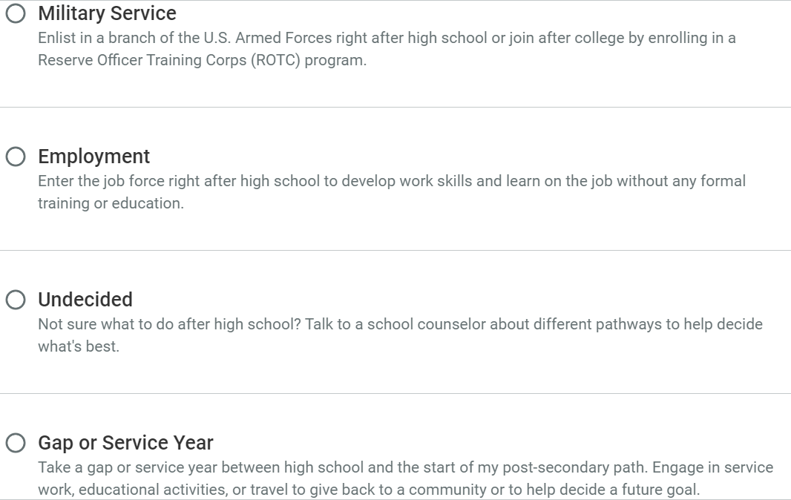
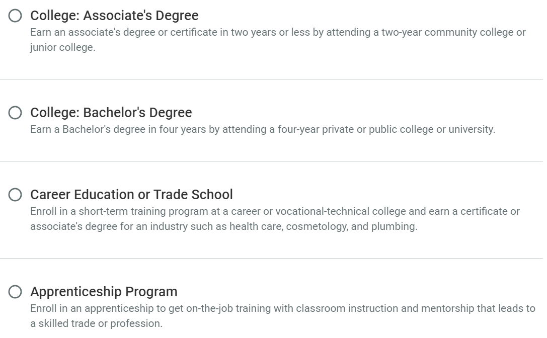
Select your path
YOU CAN ALSO CHOOSE A SECONDARY PATH IF YOU ARE STILL DECIDING!
Notes:
Choosing a path individualizes content on Naviance for each student. There are 8 pathway options:
College: Associate's Degree – earning a degree or certificate in 2 years (usually at a junior college or 2 year college)
College: Bachelor's Degree – earning a degree in 4 years by attending a private or public college or university
Career Education or Trade School – training programs usually at a technical college that earns you a certificate or associate's degree for an industry (e.g. health care, cosmetology, welding, plumbing)
Apprenticeship Program – on-the-job training (usually paid) that leads to a trade or profession
Military Service – enlisting in a branch of the military right after high school or joining after college (Army, Navy, Air Force, Marine Corps, Coast Guard, Space Force)
Employment – entering the work force right after high school with no formal training or education
Undecided – not sure yet
Gap or Service Year – taking a year off between high school and your post-secondary path (sometimes looks like volunteer or mission work depending on what your interests are)

Slide 37
Enter/update Your Email Address
We need your personal email address so we can communicate important information with you. Please get in the habit of checking email frequently.
Click on the “About Me” link at the top.
Click on “My Account.”
Click on the Pencil Icon in the “Contact Information Box.”
Enter your personal email address.
Click “Save.”
Notes:
Make sure students enter in their personal email and not CCSD email

Slide 38
You can use Naviance for…
College and Career Planning
Resume Building
Communication with your Counselor
Scholarship Searches

Slide 39
Complete the Junior Bridge Law Survey
Go to My Planner and click Tasks
Select 11th Grade - BRIDGE Law Survey
Select take this survey on the right side of the screen. Look for the pink diamond with a white arrow.
Click Start
Answer the questions and select Save and Finish

Slide 40
“The best way to predict the future is to create it.” - Abraham Lincoln
Just think about it ☺

